Slide 1
Mantid Release Presentation
Release 3.4
ISIS

Slide 2
What is this meeting
Release 3.4
Released on Monday 18th May
Present the changes and improvements
Talk to the team

Slide 3
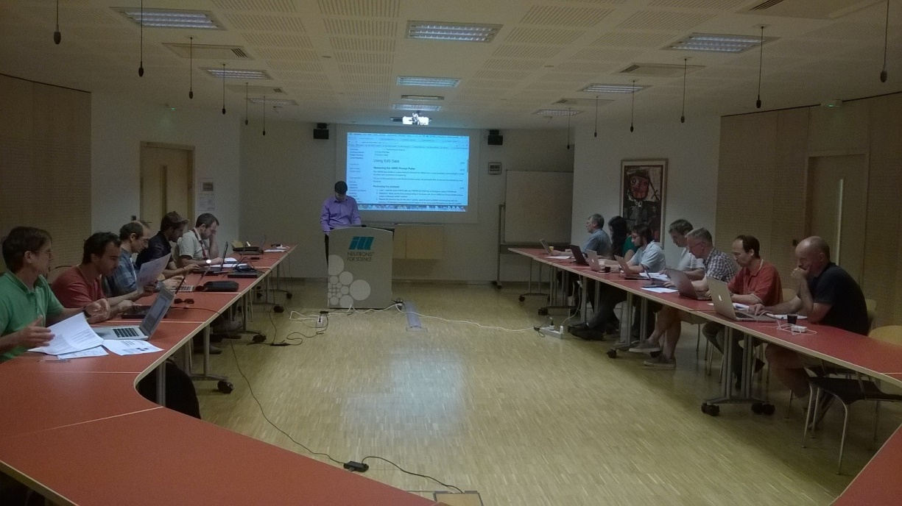
Training Courses
Dates
Neutron Training Course
Next courses
September 2015
January 2016
To Book
Email: nick.draper@stfc.ac.uk
More details at www.mantidproject.org

Slide 4
User Interface

Slide 5
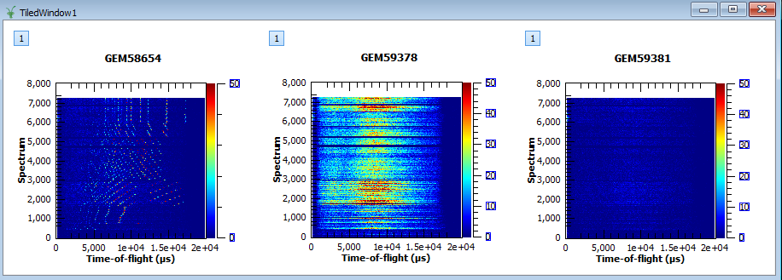
Tiled Windows

Slide 6
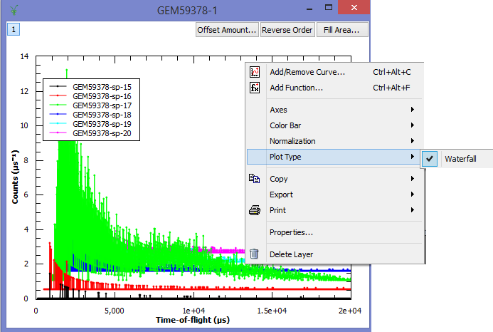
Water Fall Plots

Slide 7
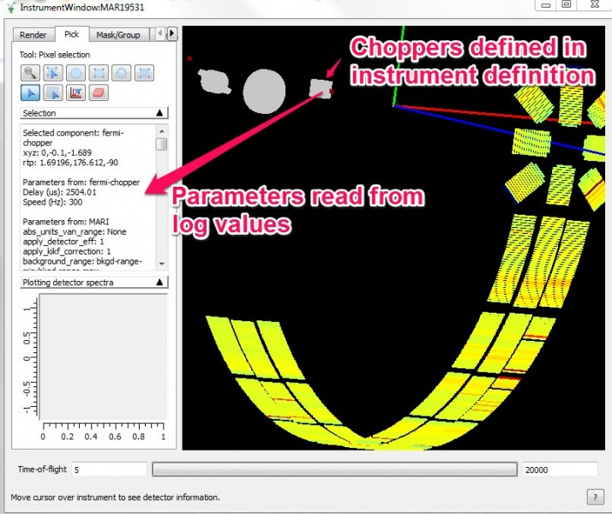
Non-detector Components

Slide 8
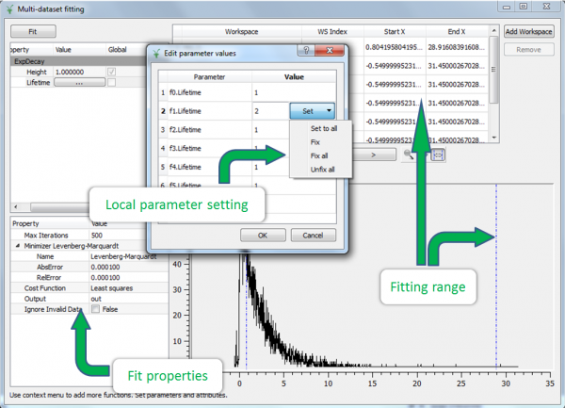
Multi-data Fitting

Slide 9
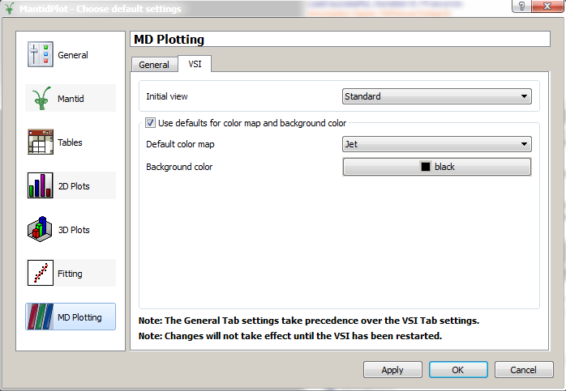
MD Viewer (VSI)

Slide 10
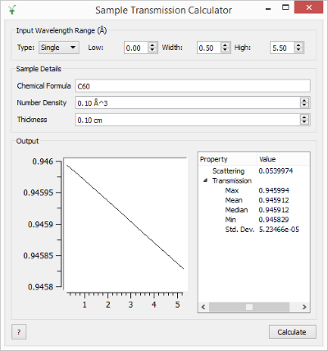
New Sample Transmission Calculator

Slide 11
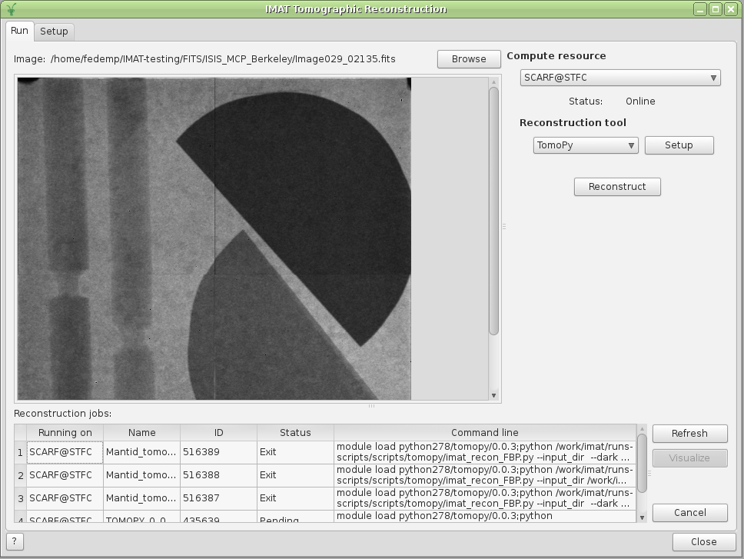
Other Important Changes
Tomographic Reconstruction User Interface
SliceViewer, LineViewer and PeaksViewer

Slide 12
Framework

Slide 13



Framework – Improvements
ParaView bundled with the installation packages
Instrument definitions
LET, ALF and others at SNS updated
You get these updates automatically since v3.3
Infrastructure for distributed computing
Algorithms:
~40 new ones
~100 improved/extended

Slide 14
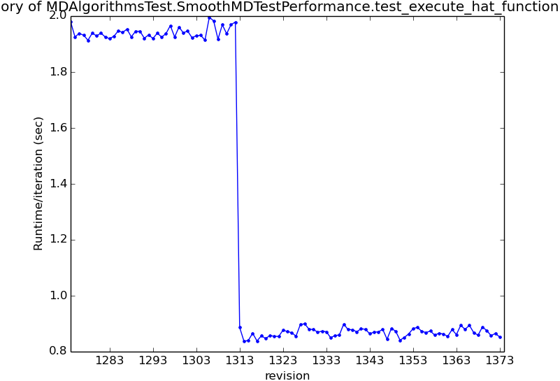
Performance Improvements
MergeMDFiles – Manages memory more efficiently, improving performance up to 30%
MergeMD – Only loads experiment information when needed, can save hours in a large MergeMD run
SaveNXSPE – Writes to disk more efficiently
Runs 2x faster
Now saves to CEPH quickly
LoadNexusProcessed loads multi-period workspaces more efficiently, up to 100x faster
Project saving places multiperiod data in a single Nexus file now, which is approximately 5x faster
SmoothMD and some other multi-dimensional algorithms are running 2x faster than they were during testing
Notes:
14

Slide 15
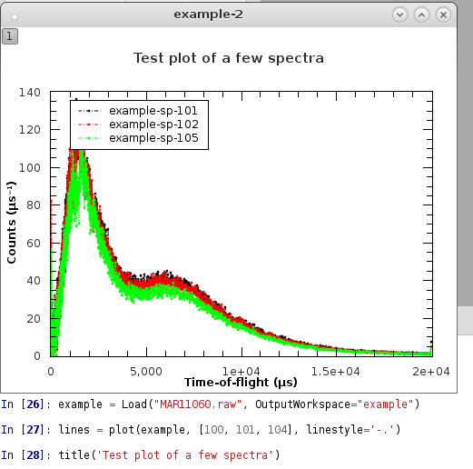
Python Plotting Command Line Interface
New Python plotting interface now available by default. Like:
Python matplotlib
Matlab plot commands
Interface:
Supports: plotSpectrum / Bin / MD
Interface:
Functional
Object-oriented
kwargs: linestyle=‘-.’, color=‘red’
VSI planned – feedback welcome
Not to be confused:
Matplotlib - also shipped
(import matplotlib)

Slide 16
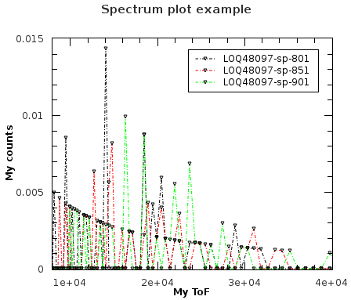
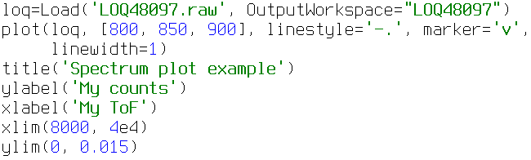
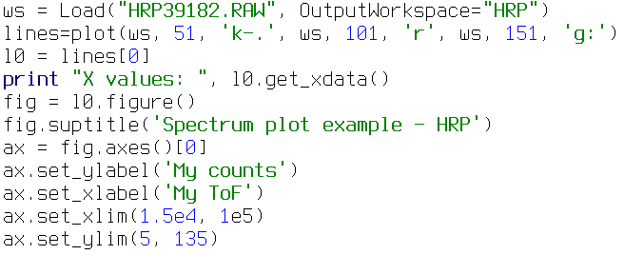
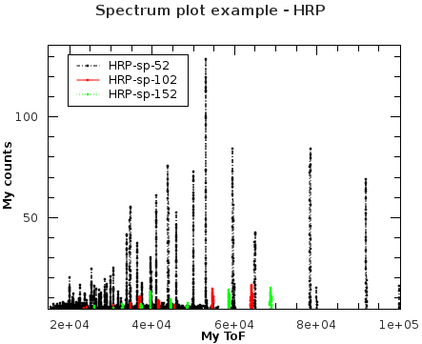
Python Plotting Command Line Interface
Plotting spectra, functional interface:
Object-oriented interface (Figure, Axis, Line2D, etc.):

Slide 17
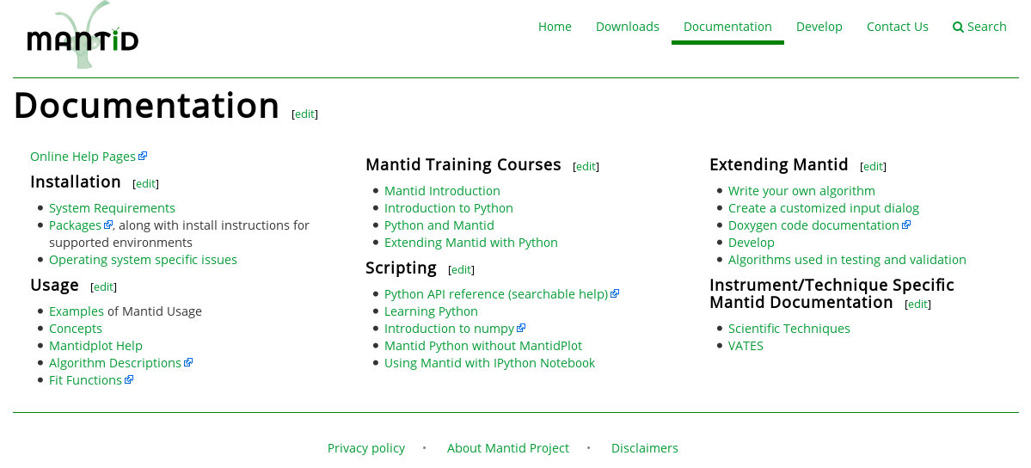
Python Plotting Command Line Interface
To learn how to use it:
help(pymantidplot.pyplot)
http://docs.mantidproject.org/nightly/api/python/index.html
Familiar interface, >90% like the Pyplot tutorial: http://matplotlib.org/users/pyplot_tutorial.html
Courses Sep/Jan

Slide 18
Indirect Inelastic

Slide 19
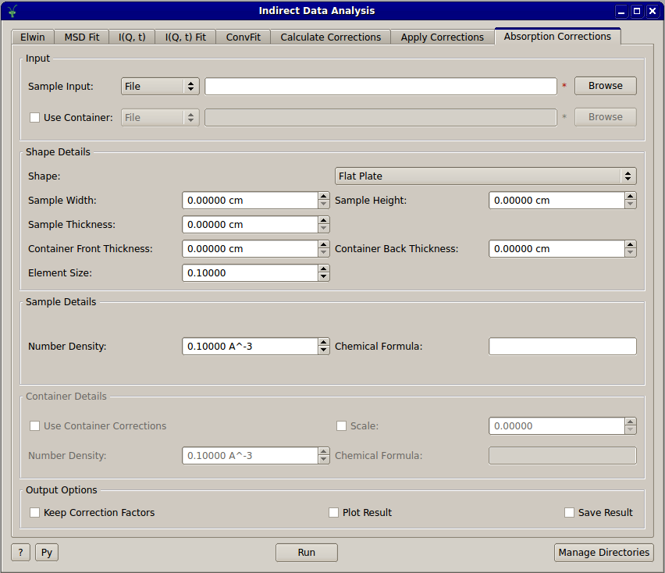
Absorption Corrections
Added cross platform absorption correction algorithms based on those already in MANTID
New tab on Indirect Data Analysis to provide a simplified interface to the algorithms
Notes:
19

Slide 20
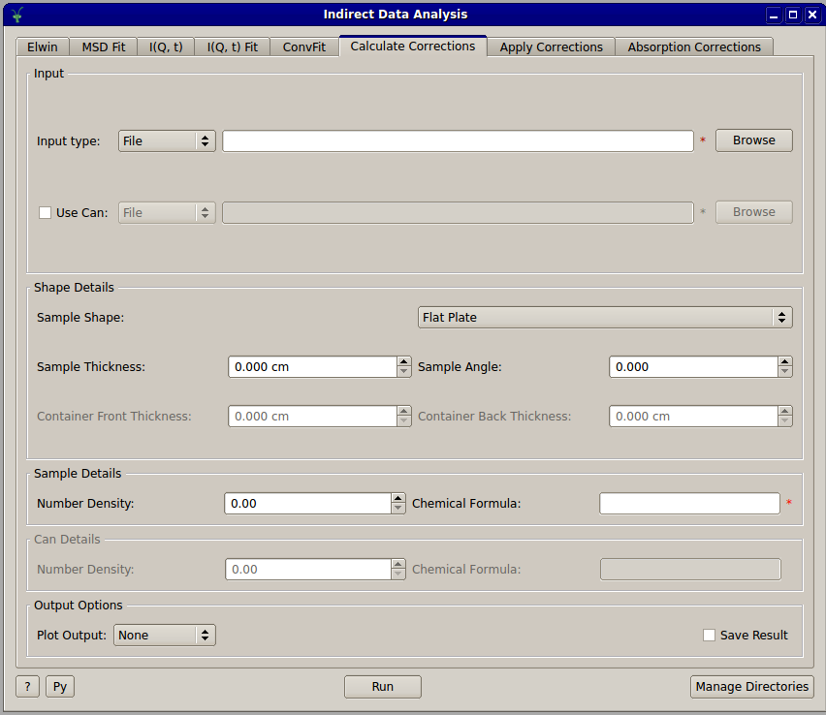
Absorption Corrections
Major refactor of old absorption correction routines
In preparation of porting cylinder absorption routine from FORTRAN
Updates to the Calculate and Apply Corrections interfaces

Slide 21
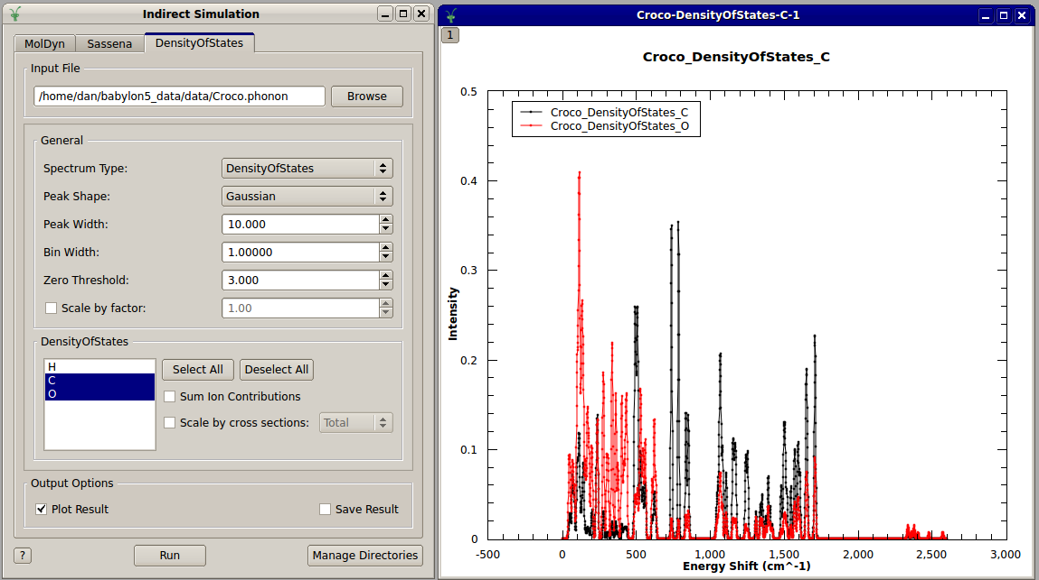
Interface Updates
Added DensityOfStates tab to Indirect Simulation interface
Allows easier selection of a partial DOS from CASTEP output

Slide 22
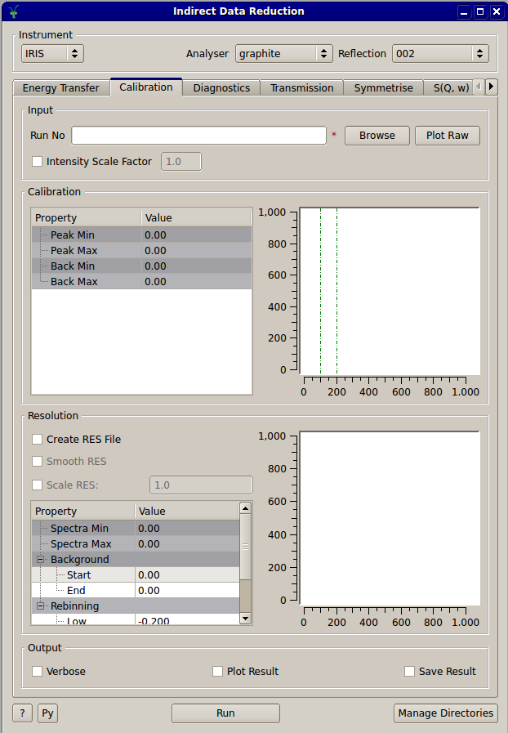
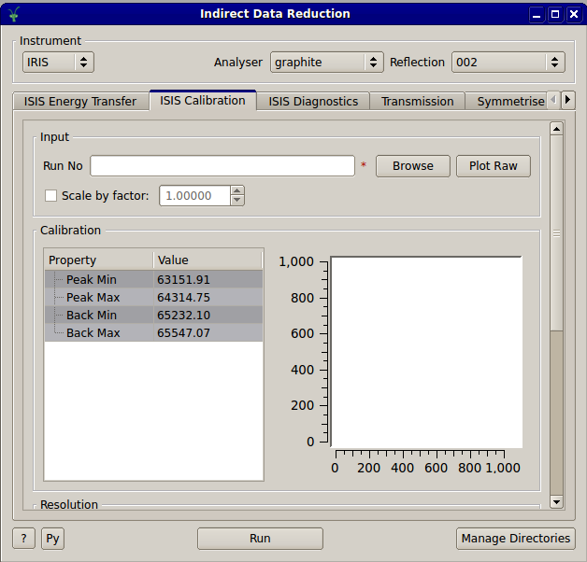
Interface Updates
Various indirect interfaces modified to be usable on low resolution displays

Slide 23
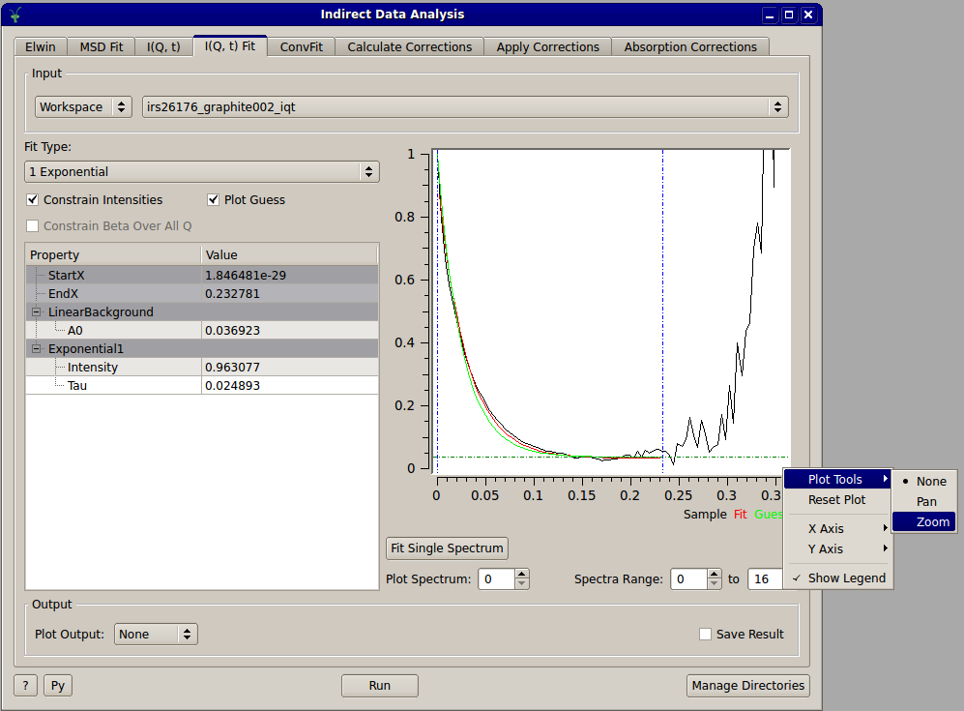
Interface Updates
Standard preview plot widget in all indirect interfaces
Supports:
Changing axis scales
Pan tool
Zoom tool
Automatic zooming
Legend toggle

Slide 24
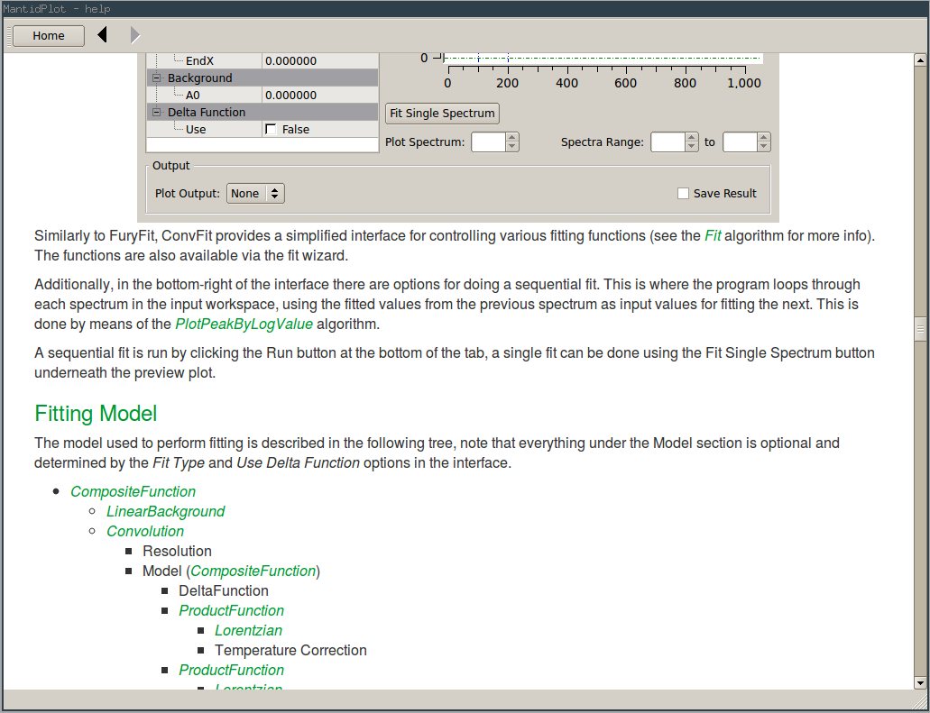
Interface Documentation
Added offline documentation for all indirect user interfaces
Accessible from ? Button in bottom left of interface window

Slide 25
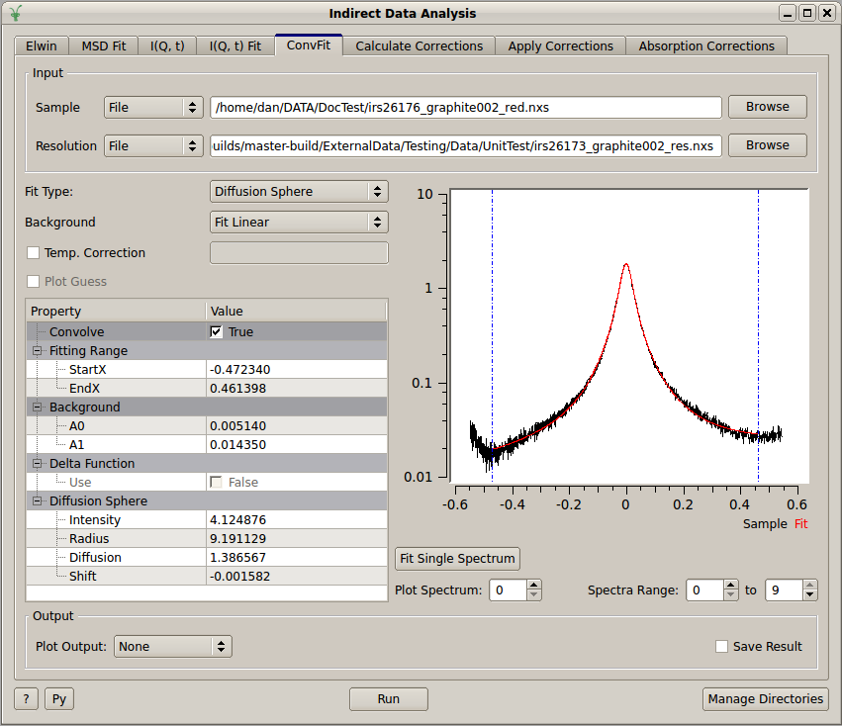
ConvFit
Add support for DiffSphere and DiffRotDiscreteCircle to IDA ConvFit interface

Slide 26
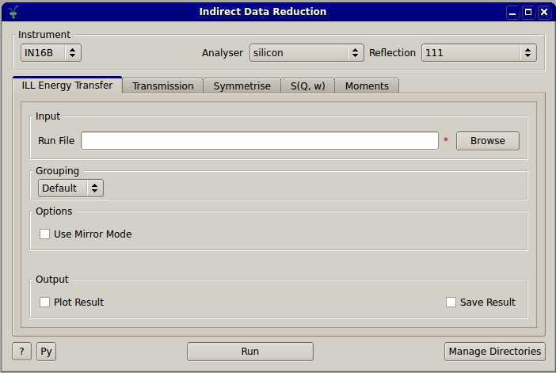
IDR Multiple Facility Support
Added support for IN16B reduction on Indirect Data Reduction
Allow entire UI to be customised per facility

Slide 27
SANS

Slide 28
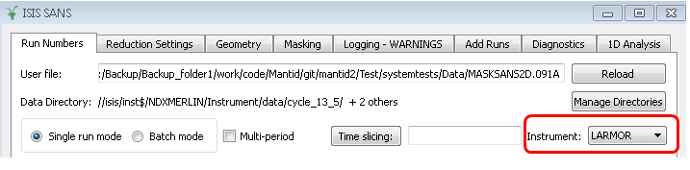
SANS
ISIS SANS GUI
Support for LARMOR
Allow added event files to be reduced !
SasView
Overhaul of documentation
New models added

Slide 29
Muon

Slide 30
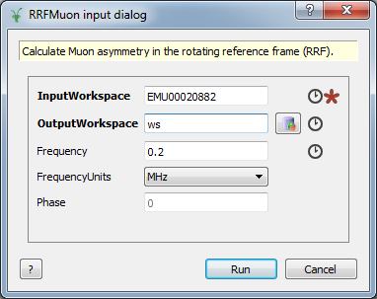
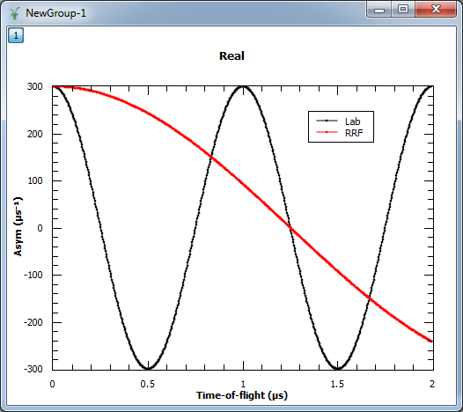
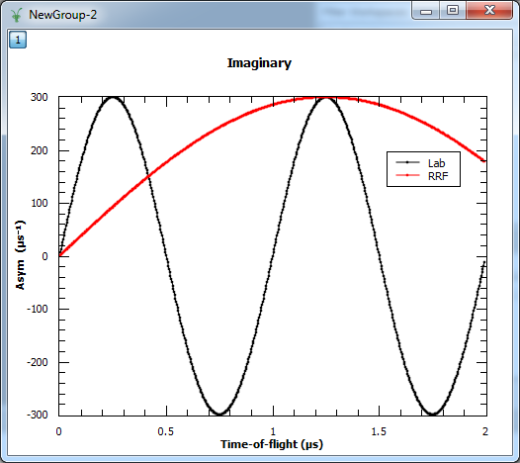
New RRFMuon algorithm
Real + Imag part of a signal
Frequency units:
MHz
Gauss
Mrad/s

Slide 31
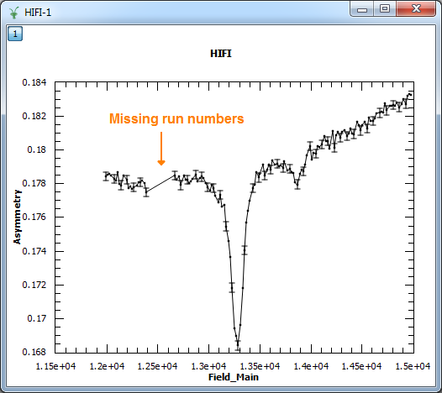
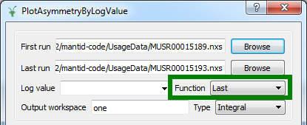
Existing algorithms
LoadMuonNexus
Correct labelling of specified spectra (Min/Max/List)
DeadTimeTable and DetectorGroupingTable containing
specified spectra only
PlotAsymmetryByLogValue
Missing run numbers are
allowed
Functions of LogValue:
Mean, Min, Max, First, Last

Slide 32
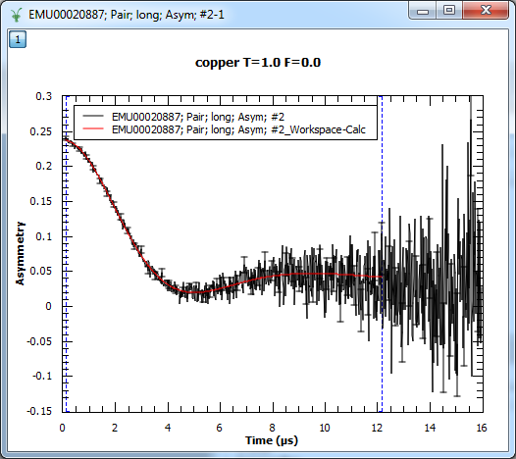
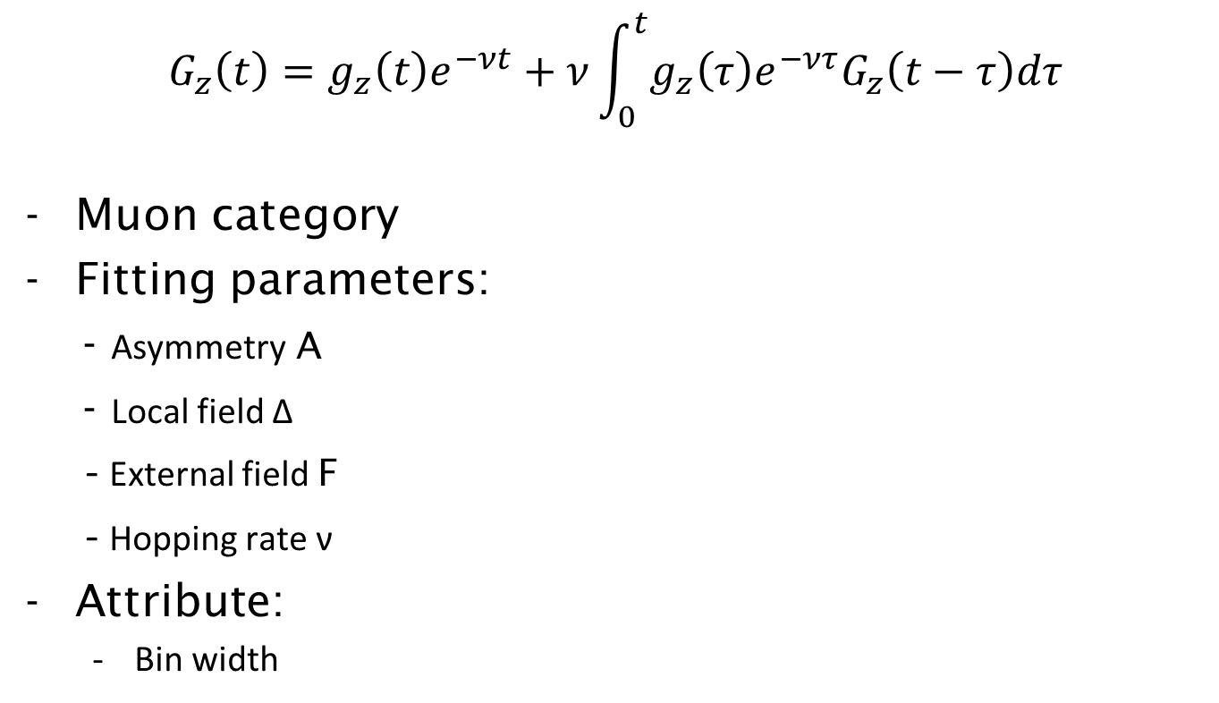
DynamicKuboToyabe fitting function
$$G_{z}\left(t\right)=g_{z}\left(t\right)e^{−νt}+ν\int_{0}^{t}{g_{z}\left(τ\right)e^{−ντ}G_{z}\left(t−τ\right)dτ}$$
Muon category
Fitting parameters:
- Asymmetry A
- Local field Δ
- External field F
- Hopping rate ν
Attribute:
Bin width

Slide 33
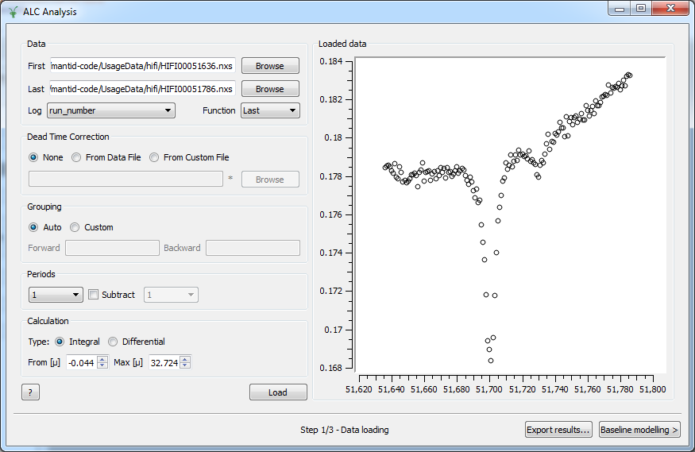
ALC Interface
Help buttons “?” & “Export results…”
DataLoading:
Progress bar
Missing options added

Slide 34
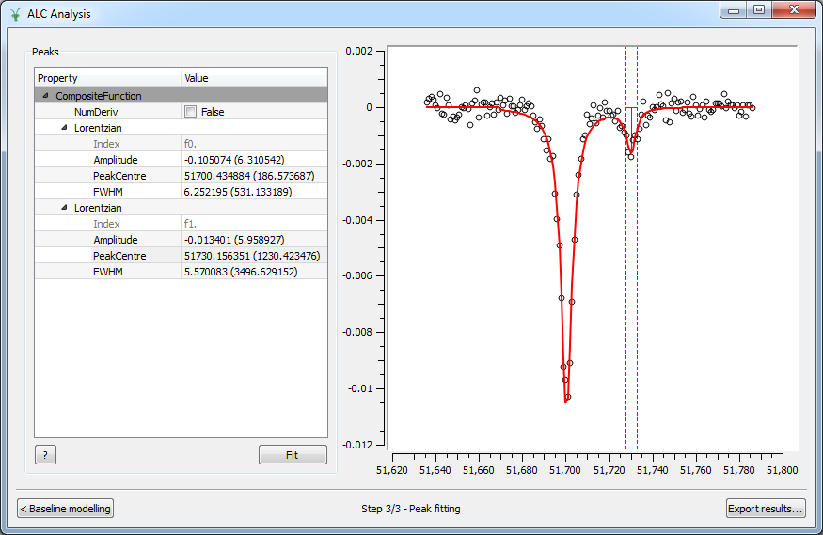
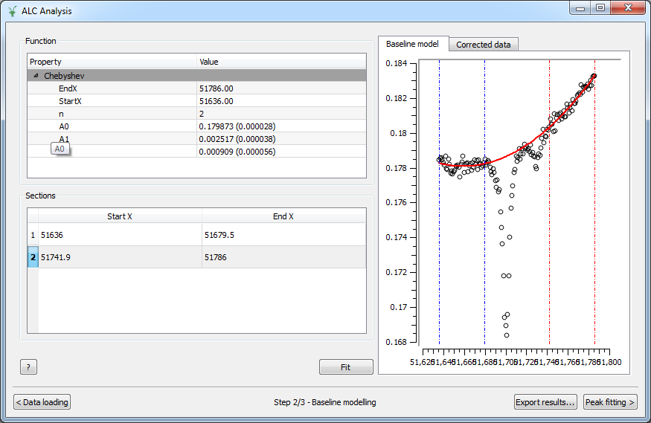
ALC Interface
Parameter errors
BaselineModelling: range selectors

Slide 35
Direct Inelastic

Slide 36
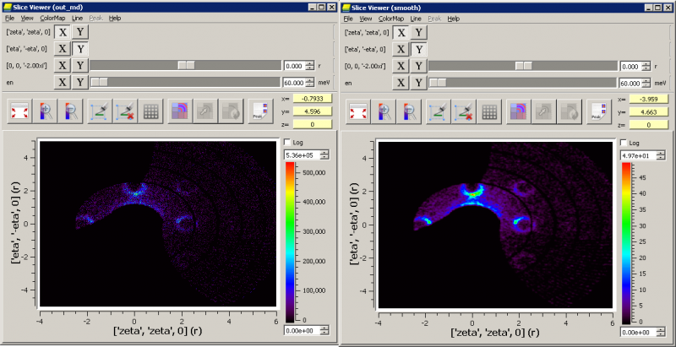
Horace Style Commands
CutMD equivalent to cut_sqw
Introduction of Horace style Projections into Mantid
CreateMD equivalent to gen_sqw
Creates merged workspaces in one step
With a file-backed mode
SmoothMD equivalent to smooth
IntegrateMDHistoWorkspace

Slide 37
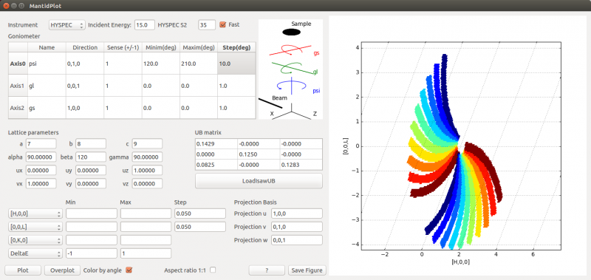
New DGS Planner

Slide 38
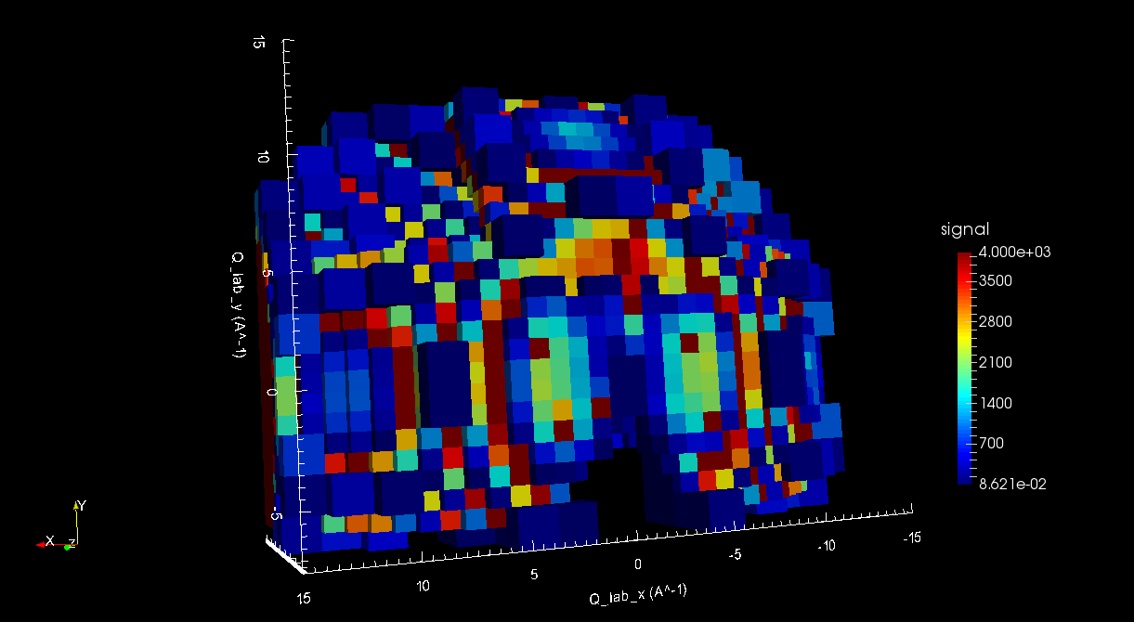
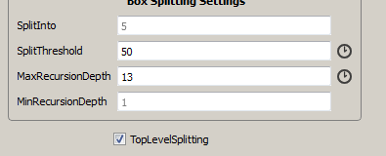
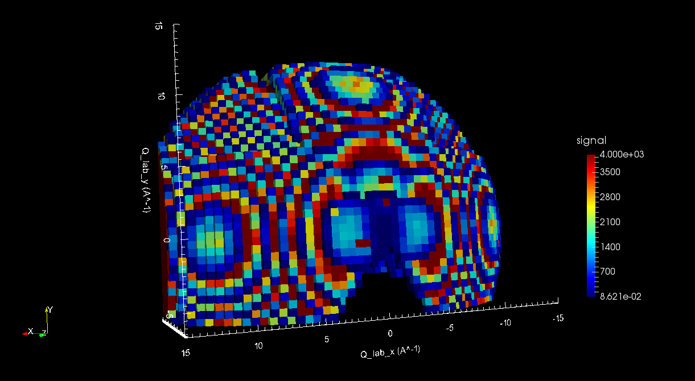
Top Level Splitting

Slide 39
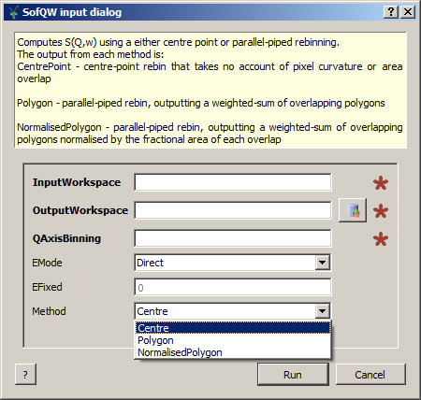
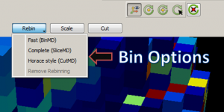
Other Important Changes
SofQW algorithms renamed. Method introduced.
Error propagation issue tracked down and fixed
Performance improvements
DGS planning tool
VSI Binning Options

Slide 40
Diffraction

Slide 41
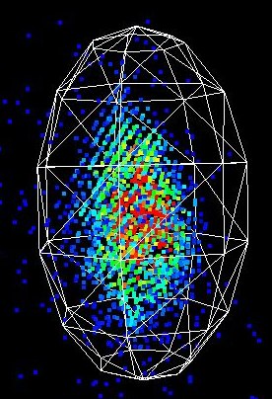
SC Peak Integration
IntegrateEllipsoids
Can now be run on 2D histogram workspaces
Account for weighted events
Now parallel processes as part of the PCA
IntegratePeaksMD
Fix to the adaptive Q radius calculation
Caches used for speed improvement
PeakShape introduced
Frame
Algorithm + Version
Flexible + extendable shape definition
Used in the 3D visualisation tools

Slide 42
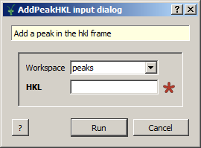
New Algorithms
StatisticsOfAPeaksWorkspace
AddPeakHKL
Horace style algorithms
CutMD,
CreateMD,
SmoothMD,
IntegrateMDHistoWorkspace

Slide 43
PeaksViewer for VSI
Demo

Slide 44
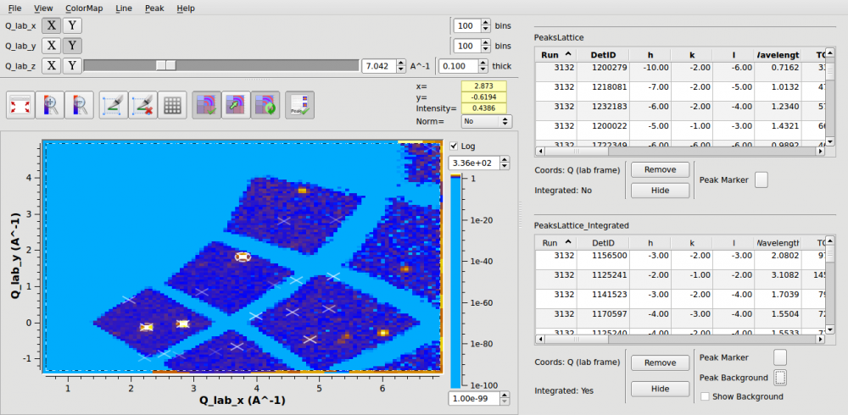
PeaksViewer
PeaksViewer mode of SliceViewer now supports drag-drop
PeaksViewer is now completely synchronised via MantidPlot’s PeaksWorkspaces
Up-down keyboard keys on the mini-table give zoom-to-peak feature

Slide 45
Next Release

Slide 46
Release v3.5
Planned Release Date: Monday 5th October 2015
Mantid Roadmap
http://trac.mantidproject.org/mantid/roadmap

Slide 47

Thank you

